Slide 1
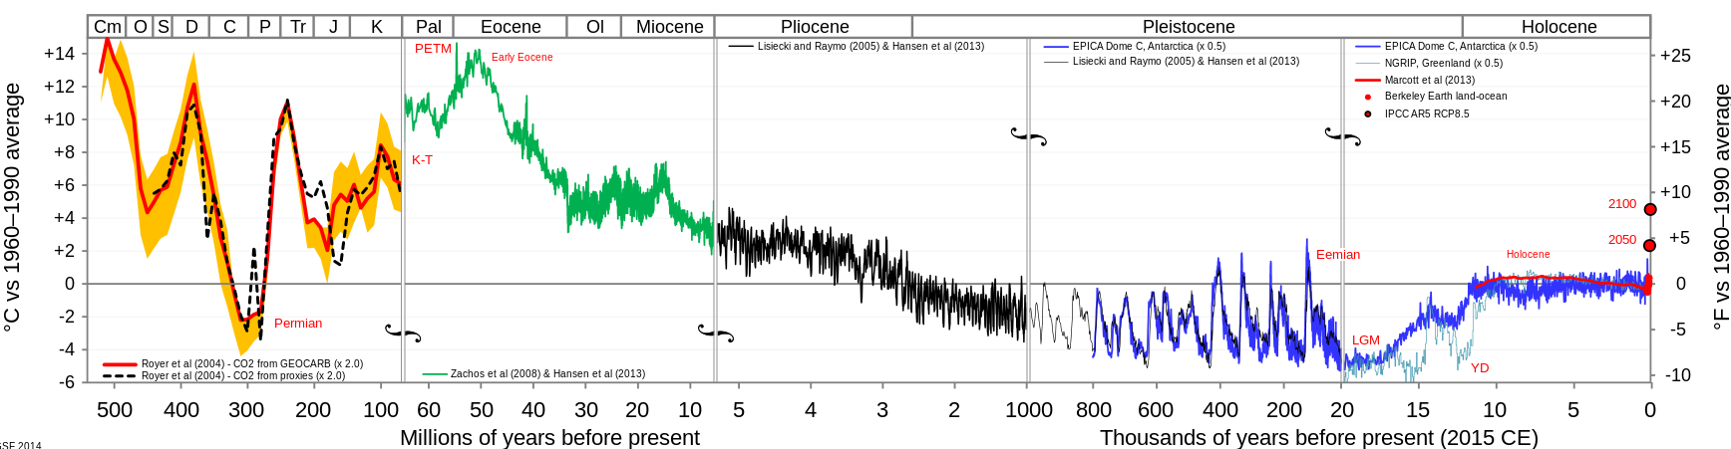
Climate synchronicity in the Pleistocene
Past Present
Hothouse Earth
Icehouse Earth
Glacial-interglacial cycling

Slide 2
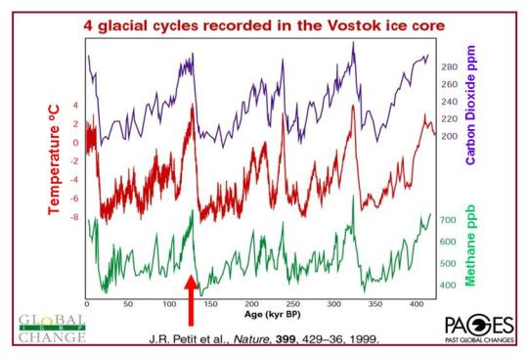
Climate synchronicity in the Pleistocene
Present Past
The fact that temperature, CO₂, and CH₄ are in very tight correlation suggests a positive feedback loop, like power steering in an automobile.
Over the last few million years, Milankovich wobbling is driving.
Now, human emissions are driving.

Slide 3
Climate synchronicity in the Pleistocene
Before, we asked two fundamental questions:
Do we have the amplification (feedback) right?
Mechanism
Parameterization
Implementation (algorithm)
What exactly are we trying to represent?
Now, with the Synchronicity CGI, you can explore
The effects synchronization might have on these variables (temperature, CO₂, and CH₄)
Present Past

